Slide 1

WATER LEAKAGE MANAGEMENT SYSTEM
1
Category: Wireless and sensors

Slide 2
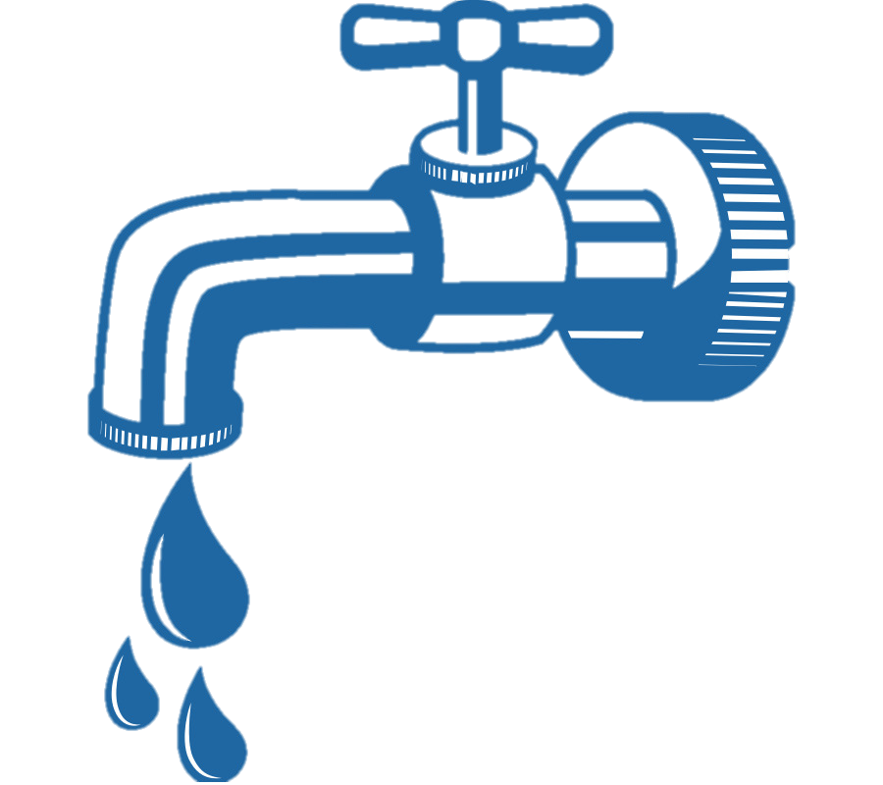
2
INTRODUCTION:
One of the most common and least productive wastes of water is a leaky pipe.
A average family can waste 180 gallons per week.
A report that the average household can leak more than 10,000 gallons of water per year.

Slide 3
3
Our Vision
Our motto is to save the water.
Detecting the leakage of water.
Immediate action taken for controlling purpose
Alerting system for user.

Slide 4
4
MAJOR COMPONENTS:
ESP 8266 (NODE MCU).
Flow Meter.
Solenoid Valve.
Relay
TECH STACK:
IOT

Slide 5
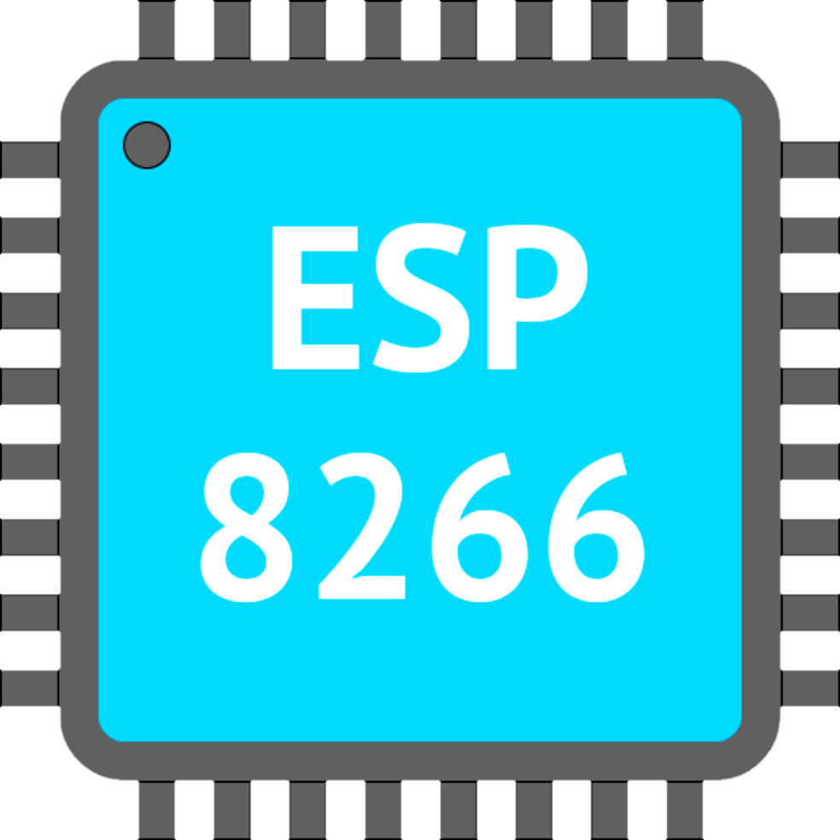
ESP 8266 :
The Node MCU project incorporates firmware with a prototyping board (which in turn has an MCU module board mounted on it). The name "Node MCU" combines "node" and "MCU" (micro-controller unit).
Arduino-like hardware
Port Reset/Flash buttons
Interactive, Programmable, low cost
ESP8266 with inbuilt WIFI

Slide 6

RELAY :
A relay is an electrically operated switch. It consists of a set of input terminals for a single or multiple control signals, and a set of operating contact terminals.
Digital output controllable Compatible with any 5V microcontroller such as Arduino.
Control signal: TTL level;
Rated through-current: 10A (NO) 5A (NC).

Slide 7
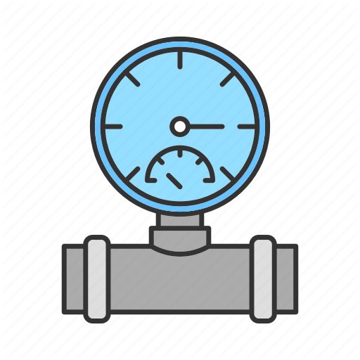
WATER FLOW SENSOR :
This sensor sit in line with your water line, and uses a pinwheel sensor to measure how much liquid has moved through it.
Measure liquid/water flow for your solar, water conservation systems, storage tanks, water recycling home applications, irrigation systems and much more.
The sensors are solidly constructed and provide a digital pulse each time an amount of water passes through the pipe.
The output can easily be connected to a microcontroller for monitoring water usage and calculating the amount of water remaining in a tank etc.

Slide 8

SOLENOID VALVE :
Solenoid valve is an electro-mechanical valve that is commonly employed to control the flow of liquid .
Can also be used in :
Water and fuel supply
Treatment of drinking water
Waste water treatment
Firing systems

Slide 9
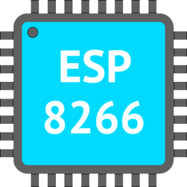
5
BLOCK DIAGRAM :
WATER TANK
SOLENOID
VALVE
FLOW
METER
FLOW METER
PIPE LINE
ALERTING
SYSTEM

Slide 10
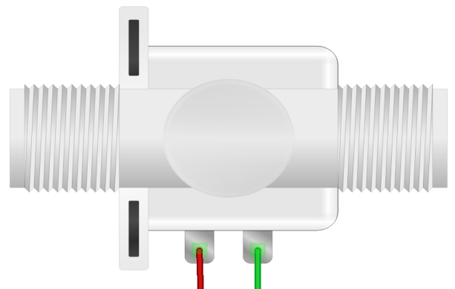
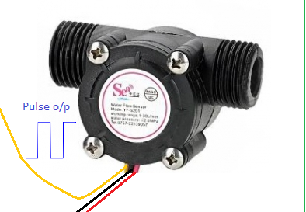
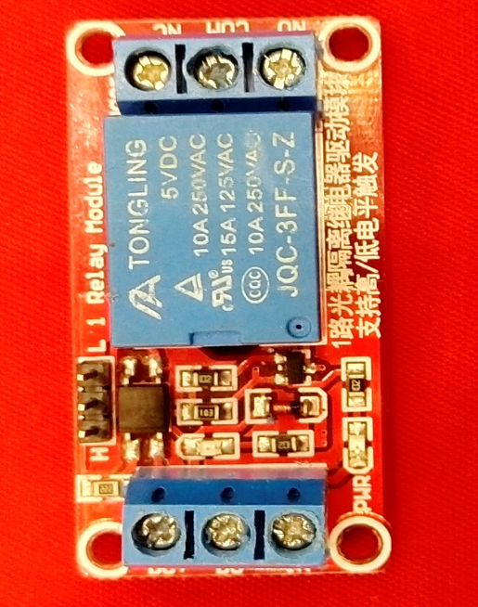
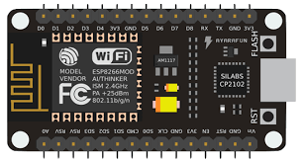
12v dc adapter

Slide 11


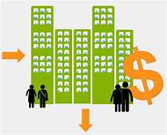
6
USE CASES:
HOME
APARTMENTS
OFFICE

Slide 12



ADVANTAGES:
Economic and easy to install
Water can be saved in a efficient manner
Quick repairing and maintenance.

Slide 13
FUTURE DEVELOPMENT:
Detecting the particular location of leakage
By further development we can also use it for detecting leakages in larger pipeline systems.

